Slide 1
Cost concept

Slide 2
Cost
Cost is a resource sacrificed or foregone to achieve a specific objective. It is usually ensured as the monetary amount that must be paid to acquire goods and services.
A measurement of what must be given up in order to in order to obtain something.
The value of the inputs needed to produce any goods and services, that has to be measured in some units usually money.
The amount paid for a thing is called cost or cost is the amount of expenditure incurred on a given thing.

Slide 3
1. Production costs/manufacturing cost, costs involved directly to convert the raw materials into finished goods are called production costs. This cost is also called manufacturing expensive. Direct labour cost, direct materials cost, and direct expenses are production costs.
Manufacturing cost can be further divided into
a. Prime cost or direct cost
Prime costs are those costs which are related directly with the product. Prime cost is the aggregate of the following three elements.
i. Direct materials cost: it is the cost associated with those materials and components that can be directly and conveniently traced to a unit of product. Cost of paper in a book, wood in furniture, metal in bridge are some examples of direct materials costs.

Slide 4
ii. Direct labour cost: the costs of production labour that can be directly and conveniently traced to a unit of product are called direct labour costs. Costs associated with chef in restaurant, welders in metal fabrication, carpenters or masons in building works, machine operators in manufacturing operations are some examples of direct labour costs.
iii. Direct expenses: the production expenses that can be directly and conveniently traced to a unit of product are direct expenses. Special design and drawings, hire of special tools and equipment etc are some examples of direct expensive.
b. Overhead costs indirect costs.
Overhead costs are related to the particular cost object that cannot be traced to specific units of product. Overhead cost is the aggregate of following three elements.
i. Indirect material costs: the costs of materials not directly traceable, and those extremely small in monetary value are called indirect material cost. Cost of glue used to bind the book, screws in a furniture factory, dishwasher detergent in a fast food restaurant etc are some examples of indirect materials costs.

Slide 5
ii. Indirect labour cost: the labour costs that are not directlytraceable, or those extremely small in monetary value are called indirect labour costs. Costs associated with storekeeper, night security guards etc are some examples of indirect labour costs.
iii. Indirect expenses, the expenses that are not directly traceable, or those extremely small in monetary value are called indirect expenses. Factory rent, depreciation of plant and machinery ect are some example indirect expenses.

Slide 6
2. Non manufacturing costs
Non manufacturing costs include all costs associated with the activities carried out in support of any manufacturing operations. These costs are not directly associated with the production. All these costs are happened after the production process. Non manufacturing costs can be further classified in to the following types;
a. Administrative costs
b. Selling and distributing cost
c. Research and development cost

Slide 7
Fixed cost, cost that does not change with output is called fixed cost. It remained fixed for a certain period and for a specified capacity outputs. It is also called constant cost. Increases in output decreases fixed cost per unit and decreases in outputs increases fixed cost per unit. Examples of fixed costs are depreciations of fixed assets, salary to the staff, office and factory rent etc.
Variable costs, costs which change proportionately with the volume of outputs or services are called variable costs. They increase or decrease in the total amount with the increase or decrease in volume of output. Direct materials cost, direct labour cost are some examples of variable cost

Slide 8
Differential cost and differential revenues
A difference in cost between any two alternatives is known as differential cost. A difference in revenue between any two alternatives is known as differential revenues. Differential cost includes both cost increase (incremental cost) and cost decrease (detrimental cost). In general the difference (cost and revenue) between alternatives are relevant in decision making. Those items that are the same under all alternatives can be ignored.

Slide 9
Opportunity Cost: The value of the next-best alternative foregone when a choice is made (e.g., working instead of studying means lost potential future earnings).
Mr A had two choices, first giving his property for rent which would earn Rs 120000 yearly.
Second, running own business, if he has chosen the second option then the probable income form the first alternative ie Rs 120000 is an opportunity cost.
The value or revenue of passing up the next best choice when making a decision is called opportunity cost.

Slide 10
The cost of best rejected opportunity to earn return is called opportunity cost.
It is hidden or expected cost but important for decision making process. .In microeconomic theory, the opportunity cost of a choice is the value of the best alternative forgone, in a situation in which a choice needs to be made between several mutually exclusive alternatives given limited resources.

Slide 11
Sunk cost
A sunk cost is a cost that has already been incurred and cannot be recovered.
Key Features of Sunk Costs:
Irrecoverable – Once spent, the money or resources cannot be regained.
Past Expense – Related to decisions already made, not future actions.
Not Relevant for Future Decisions – Rational decision-making should ignore sunk costs.

Slide 12
Sunk cost
• All the past (previous) costs which cannot be recovered when a firm leaves from an industry. Sunk costs have no relevance to decision making in future.
• Cost of engineering design, wages, registration, license, decoration, depreciation etc. are the examples of sunk cost.

Slide 13
Incremental cost
The change in total cost due to change in one unit of extra output is called incremental cost. It is also called marginal cost.
MC = CHANGE IN TOTAL COST DIVIDED CHANGE IN OUTPUT QUANTITIY
Average cost
It is per unit cost of any output level.
AC = TOTAL COST DIVIDED BY QUANTITY OUTPUT

Slide 14
Recurring cost
All the costs which are occurring over the production process on a continuing basis. All the variable as well as fixed costs which are paid as a repeatable basis is recurring cost.
Rent, wages, salary are some examples of recurring cost.
Non recurring cost
Those costs which are not occurring or repeating over a production process
It involves the cost of developing capacity to operate
Purchase cost of land, plant ect

Slide 15
Life cycle cost: in engineering practice, the term life cycle cost is often encountered. Life cycle cost is the sum of all expenditures associated with the item or project during its entire service life. The life cycle begins with identification of the economic need and ends with retirement and disposable activities. It may also be expressed as the summation of acquisition, operation, maintenance and disposable costs.
- Life cycle cost consists following three components
- First cost or initial investment, capital cost
- Operating and maintenance costs
- Disposal costs

Slide 16
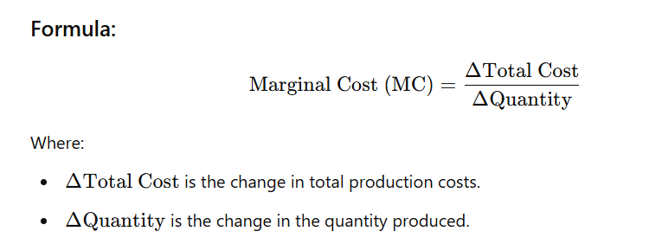
Marginal cost
Marginal cost is the additional cost incurred when producing one more unit of a good or service. It is calculated as the change in total cost resulting from a one-unit increase in production. Marginal cost is crucial in decision-making because it helps businesses determine the most efficient level of production.

Slide 17
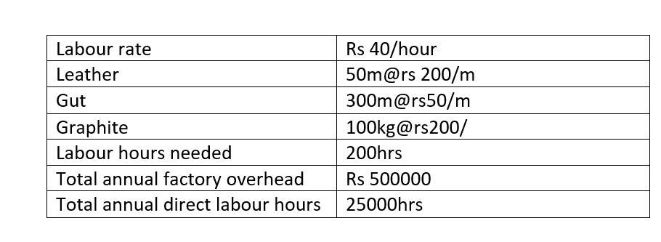
Question: following are the cost data for the production of 100 Badminton racquets.

Slide 18
Breakdown the costs into components of prime costs and overhead costs and find out the manufacturing cost of each racquet.

